Slide 1
DIP API & Webhook Response Guidance
11 June 2024

Slide 2
SIT-F Observations & Guidance
DIP Webhook Responses
During SIT Functional Cycle 1 testing it has been observed that multiple Participant systems are sending webhook response messages to the DIP without an accompanying valid Response Body (or bodies) associated with the HTTP call as per the requirements of the MHHS design as set out within the MHHS-E2E001 - End-to-End Solution Architecture document.
  (v3.6.1 - section 4.4.4 – Return Code and Response Body and in particular section 4.4.4.2 Response Body).
Participant systems should be returning an accompanying valid Response Body (or bodies) associated with a HTTP call, in JSON format, when messages with Response Code values of either ‘201’, ‘207’ or ‘400’ are returned confirming the L3 validation status of a transaction / message received from the DIP.
  If a valid Response Body (or bodies) is not included, the DIP is missing expected data against each response message. This additional information is intended for use as part of diagnostic, service mgt and reporting processes.
The programme would like to raise this observation with Participants so that this issue can be corrected as soon as possible and all systems aligned with the MHHS design documents. This ensures that all responses received from Participant systems are aligned to this standard definition for all Participants.
  This observation will be raised directly with each identified impacted Participant for investigation and resolution
  Note – Currently, this is not preventing the processing of response messages and Swagger definitions cannot mandate a response, but the Programme would like to provide the guidance that Participants are encouraged by design to provide this information to support wider diagnostic processes. Correcting this early on for all Participants would be beneficial for all.

Slide 3
API Response Guidelines – L1 Validation
Market Participant
DIP
When a Participant submits a message or a series of messages to the DIP, the DIP will respond with the one of the following response code and (optional) response bodies :
Submit Message(s)
L1 Response
Group | Category | HTTP Response Codes
2xx | Successful | 201, 207
4xx | Client Errors | 400, 401, 403, 404, 405, 408, 413, 429
5xx | Server Errors | 500, 501, 502, 503, 504, 505
Only responses sent with 201, 207 & 400 http response codes will have accompanying response body or bodies
Response Body:
transactionID | Generated by the DIP to uniquely identify the message
senderUniqueReference | Submitted by the PP to identify their message
correlationID | Generated by the DIP - only a few IFs will create a Correlation ID
sentTimestamp | Generated by the DIP – the time this response was sent
senderID | The Sender ID of the message i.e. the DIP which uses the Id 0000000000
recipientID | The DIP Id of the PP that sent the message
DIPConnectionProviderID | If a DCP sent the message, then the DCP of the message
message | Information pertaining to the error condition
help | Further information
serviceTicketURL | not yet implemented
201, 207 will have a response body for each message in the transaction (at present 207 is not actually generated)
400 will have a single response body
Note - From IR 8.1 onwards, the Response Body adopts the mandatory null design pattern so to align with message bodies e.g. Data Items must be populated with a value of null rather than left blank (“”)
Note – All Data Items mandatory within the Response Body

Slide 4
Webhook Response Guidelines – L3 Validation
DIP
The DIP will Post messages to Participants webhooks. The DIP will expect the following response from the webhook (these align to the L1 responses seen on the previous slide):
Submit Message(s)
Market Participant
L3 Response
 | Category | HTTP Response Codes
2xx | Successful | 201, 207
4xx | Client Errors | 400, 401, 403, 404, 405, 408, 413, 429
5xx | Server Errors | 500, 501, 502, 503, 504, 505
Only responses sent with 201, 207 & 400 http response codes will have accompanying response body or bodies
Response Body:
transactionID* | The transaction Id passed with the corresponding message
senderUniqueReference* | Submitted by the message sender to identify their message
correlationID* | Generated by the DIP - only a few IFs will create a Correlation ID
sentTimestamp* | Generated by the PP – the time this response was sent
senderID* | The PPs DIP Id
recipientID* | The DIP Id of either the DIP (i.e. 0000000000) or the intended recipient of the response, i.e. sender of the original message
DIPConnectionProviderID* | If a DCP is the recipient, then the DCP ID of the recipient
message* | Information pertaining to the error condition
help* | Further information
serviceTicketURL* | not yet implemented
201, 207 will have a response body for each message in the transaction (at present 207 is not actually generated)
400 will have a single response body
Note - From IR 8.1 onwards, the Response Body adopts the mandatory null design pattern so to align with message bodies e.g. Data Items must be populated with a value of null rather than left blank (“”)
Note – All Data Items mandatory within the Response Body

Slide 5
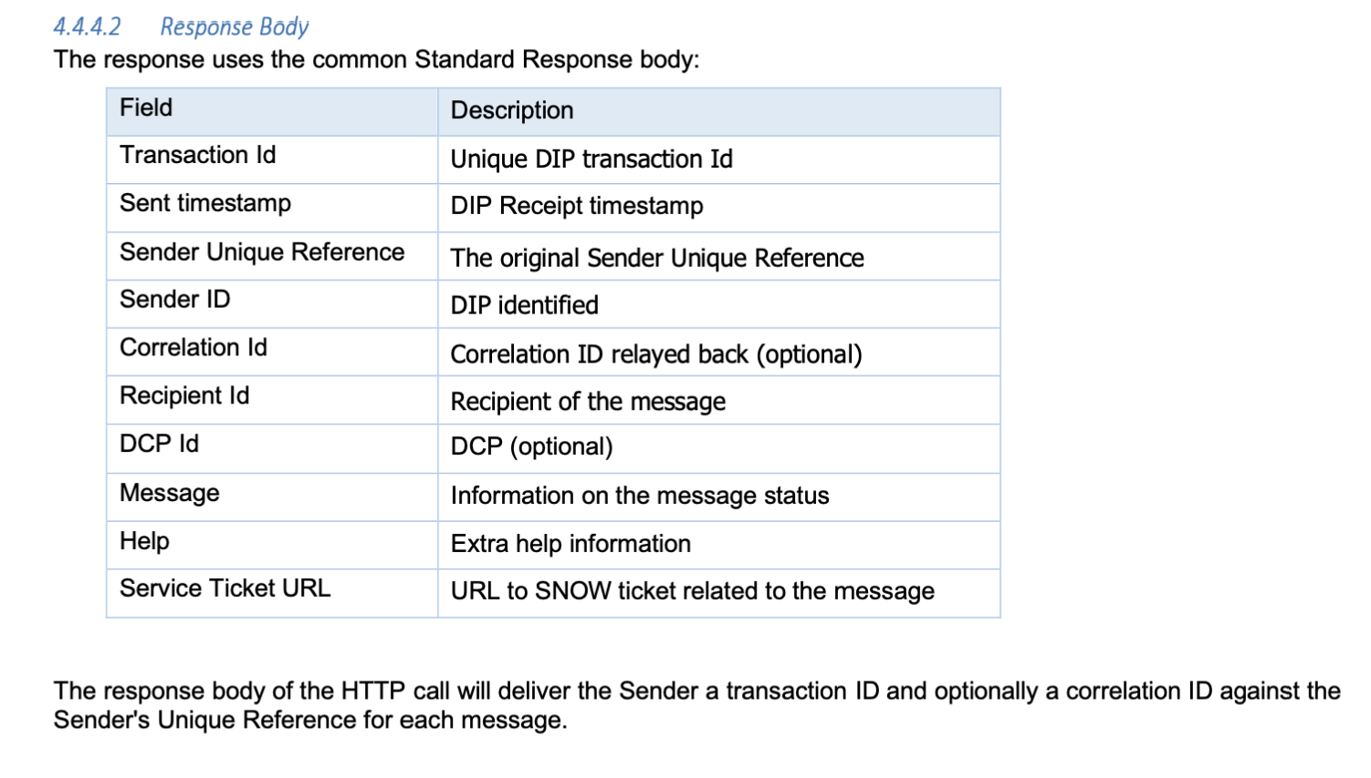
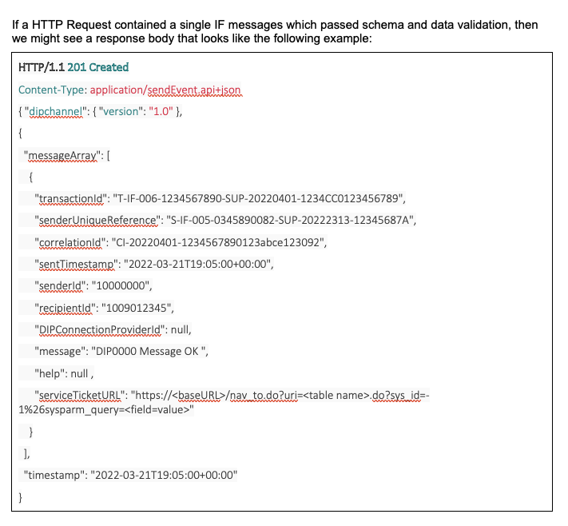
API & Webhook Response Guidelines
Observation
Multiple Participant systems are sending webhook response messages to the DIP without an accompanying valid Response Body (or bodies) associated with the HTTP call as per the requirements of the MHHS design
Please refer to the E2E Solution Architecture document & Swagger for more details on the exchange of messages within the DIP ecosystem and the use of response codes and response bodies.
Extract from MHHS-E2E001 - End-to-End Solution Architecture document
Example
Response

Slide 6

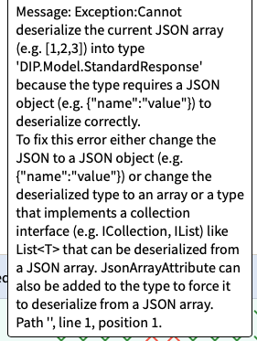


API & Webhook Response Guidelines
Observation
Exceptions relating to this observation can be seen within the DIP Message Tracker UI feature as the data is stored within the DIP Message Logs for messages received and sent for diagnostic purposes.
There are a range of exception messages logged against a message that indicate that there is an issue with the Response Body (or bodies) associated with the HTTP call. These include examples as per below.
Meaning - Participant systems are sending webhook response messages to the DIP without an accompanying valid Response Body (or bodies) associated with the HTTP call
Meaning - Participant systems are sending webhook response messages to the DIP with an accompanying Response Body associated with the HTTP call BUT the Response Body is not in a JSON format
Meaning - Participant systems are sending webhook response messages to the DIP with an accompanying Response Body (or bodies) associated with the HTTP call BUT it is not valid as an invalid character has been identified (either ‘A’ or ‘<‘).

